Slide 1
Analysing Amazon Sales data

Slide 2

Introduction
Sales management has gained significant importance in the face of increasing competition and the need for improved distribution methods to reduce costs and boost profits. Today, sales management is one of the most crucial functions in a commercial and business enterprise. By effectively managing sales operations, businesses can streamline distribution, enhance customer relationships, and ultimately drive revenue growth. Amazon shows how effective sales management leads to success. Its sales keep growing thanks to a wide range of products and a focus on customer satisfaction. Amazon’s key sales channels are online stores, physical stores like Amazon Go and Whole Foods, and third-party seller services, Amazon stays competitive and meets customer needs, proving its vital role in business success.

Slide 3
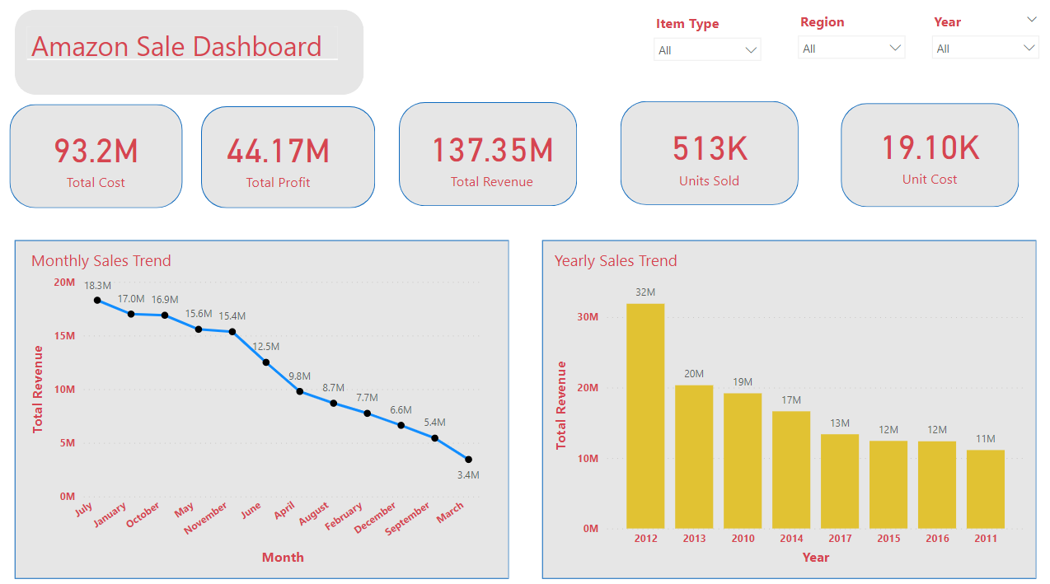
Data Visuals

Slide 4
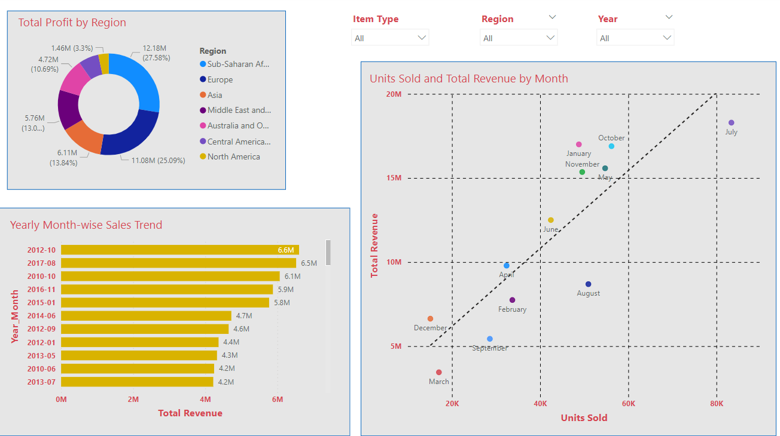
Data Visuals

Slide 5
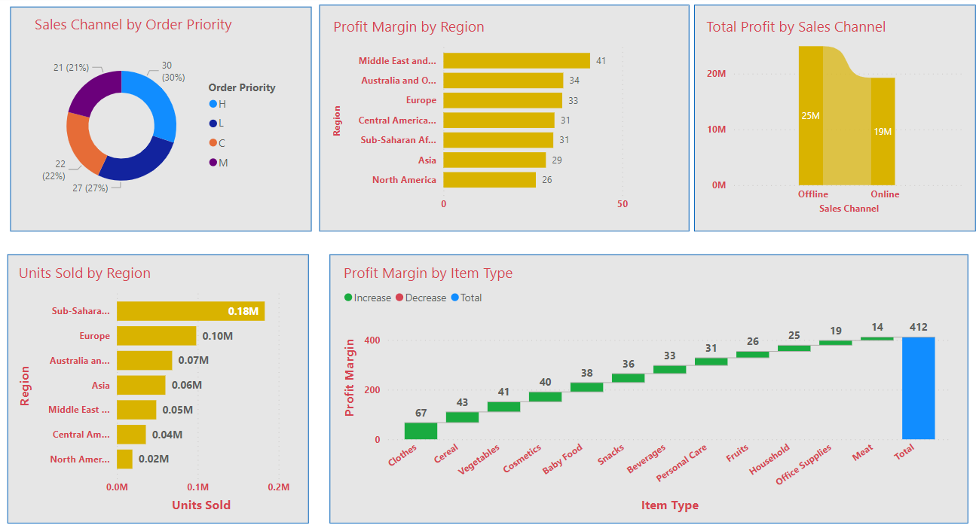
Data Visuals

Slide 6
Summary
Sales Overview
Total Revenue: $137,348,768.3
Total Cost: $93,180,569.9
Total Profit: $44,168,198.4
Total Units Sold: 512,871
Unit Cost: $19,104.8
Key Insight: Strong revenue generation with a profit margin exceeding 30%
Monthly Sales Trend-
The monthly revenue summary illustrates fluctuations in revenue throughout the year. July led with $18.3 million, followed closely by January and October at $17.0 million and $16.9 million, respectively. May and November also showed strong performance, each generating $15.6 million and $15.4 million. Conversely, March concluded with the lowest revenue at $3.4 million.
Yearly Sales Trend-
Total revenue figures highlight the financial performance across different years. In 2012, revenue peaked at $31.9 million, followed by $20.3 million in 2013. In 2010, revenue stood at $19.2 million, while 2014 saw a decline to $16.3 million. Subsequent years demonstrated a further decrease, with revenue dropping to $13.4 million in 2017. Notably, 2011 recorded revenue of $11.3 million, while 2015 and 2016 saw figures of $12.4 million and $12.4 million, respectively.

Slide 7
Summary
Total Profit by Region
It highlights the financial performance across different regions. Sub-Saharan Africa led with a total profit of $12.2 million, followed closely by Europe with $11.1 million. Asia also showed strong performance, generating $6.1 million in total profit. The Middle East and North Africa recorded $5.8 million, while Australia and Oceania brought in $4.7 million. Central America and the Caribbean followed with $2.8 million, and North America concluded with $1.5 million in total profit.
Yearly Month Wise Sale
It highlights the financial performance over different months and years. October 2012 led with $6.6 million, followed closely by August 2017 with $6.5 million. October 2010 also showed strong performance, generating $6.1 million in total revenue. The months of November 2016 and January 2015 also recorded substantial revenue, each exceeding $5.8 million. Conversely, August 2015 and June 2016 had lower revenue figures, with $6.3 million and $9.6 million respectively. Overall, these figures provide insights into revenue trends over various periods.
Unit Sold and Total Revenue by Month
It provides insights into sales performance across different regions and months. In April, Asia recorded 32,386 units sold, contributing to a total revenue of $9.8 million. August saw strong sales in Australia and Oceania, with 50,947 units sold and a revenue of $8.7 million. July was also notable, with Australia and Oceania leading in both units sold (83,395) and total revenue ($18.3 million). Overall, these figures highlight regional sales trends and revenue generation throughout the year.

Slide 8
Summary
Sales Channel by order Priority
The data reveals varying distribution patterns across regions. In Sub-Saharan Africa, order priority H accounted for the highest count of sales channels at 11, followed by L with 9. Europe also showed a significant presence of order priority H, with 7 sales channels. Conversely, Asia had a more balanced distribution, with L, C, and M each accounting for 4 sales channels. Notably, Central America and the Caribbean had a lower count overall, with C, H, and L each having 2 sales channels. Overall, these insights provide valuable information on regional sales channel distribution and order priority.
Profit Margin by Region
The analysis reveals varying performance across regions. Middle East and North Africa lead with a profit margin of 40.99%, followed closely by Australia and Oceania at 33.50% and Europe at 33.21%. Central America and the Caribbean also demonstrate strong performance with a profit margin of 31.04%. Sub-Saharan Africa follows closely with 30.71%, while Asia and North America show slightly lower profit margins at 28.64% and 25.83%, respectively. These insights provide valuable information on the profitability of different regions.
Total Profit by Sales Channel
The total profit analysis reveals that offline sales channels generated a total profit of $24,920,726.67, while online sales channels generated $19,247,471.73. This data highlights the significant contribution of offline sales channels to total profit, indicating their importance in revenue generation.

Slide 9
Summary
Unit Sold by Region
The units sold analysis shows varying sales volumes across regions. Sub-Saharan Africa leads with 182,870 units sold, followed by Europe with 98,117 units. Australia and Oceania rank third with 68,325 units sold, while Asia the Middle East, and North Africa follow closely with 59,967 and 48,678 units sold, respectively. Central America, the Caribbean, and North America have lower sales volumes, with 35,771 and 19,143 units sold, respectively.
Profit Margin by Item Type
The profit margin analysis highlights varying profitability across item types. Clothes lead with the highest profit margin of 67.20%, followed by cereal at 43.07% and vegetables at 40.98%. Cosmetics and baby food also demonstrate strong profitability, with profit margins of 39.77% and 37.55%, respectively. Snacks and beverages follow closely with profit margins of 36.14% and 33.00%, while personal care and fruits show slightly lower margins at 30.66% and 25.83%, respectively. Household items and office supplies have comparatively lower profit margins, while meat ranks lowest with a margin of 13.56%.

Slide 10
Thank You Name- Preeti R Email ID- rituganesh01@gmail.com

